Slide 1


Zen Wealth
Financial Freedom and Security
Model Portfolio Service
January 2018
This does not constitute advice. Professional advice should be taken prior to acting on any part of it.
Zen Wealth LLP is an appointed representative of Best Practice IFA Group Limited which is authorised and regulated by the Financial Conduct Authority.

Slide 2

Financial Freedom and Security
Every investor has different goals and views on the risks they are prepared to take, as well as the level of involvement they want to have with the investment solutions. Zen Wealth’s three Risk-Rated Model Portfolios makes it easy to match our clients return expectations and risk attitudes to a pre-constructed portfolio of assets.
The model portfolios are designed to help you achieve your investment objectives taking into consideration a variety of factors including your time horizon, attitude to risk and capacity for loss. As part of your Lifestyle Plan we will explore with you your unique circumstances and if appropriate map your objectives to a Model Portfolio.
Our portfolios have been designed with our core beliefs in mind. These are; capitalism works, risk and return are related, markets are efficient, diversification is essential and costs matter. These beliefs have been applied to a careful construction and selection process to build and design a range of solutions for our clients.
The typical client for the Zen Model Portfolio service would typically either have more than £250,000 in investable assets or have Tax Planning issues which may require the adviser to provide more bespoke service.
The past is not necessarily a guide to future performance

Slide 3
Model Portfolio Service
Sector | 15 Year Standard Deviation | 15 Year Return
BBGBarc Global Aggregate Bond | 8.62% | 7.78%
IPD UK All Property TR GBP | 4.42% | 5.44%
MSCI World NR USD | 12.87% | 9.42%
MSCI Emerging Markets NR USD | 19.29% | 12.84%
The Model Portfolio Service (MPS) provides a range of investment portfolios which offer our clients diversified exposure to global financial markets.
The solutions we have created provide our clients with a high level of diversification through investment in collective funds. We offer the choice of ten investment strategies and the flexibility to switch seamlessly between them without charge should your circumstances or risk appetite change.
The service is built upon three key principles:
Follow a robust investment process
Deliver risk adjusted performance
Provide a high level of personal service
We analyse data across asset classes in order to determine the long term expected return of the portfolio.
The table alongside shows a representation of the long term characteristics of the 4 major asset classes. This acts as the major building blocks for construction of our portfolios. (source Morningstar).
Source: Morningstar Adviser Workstation Returns converted to GBP.
The past is not necessarily a guide to future performance

Slide 4
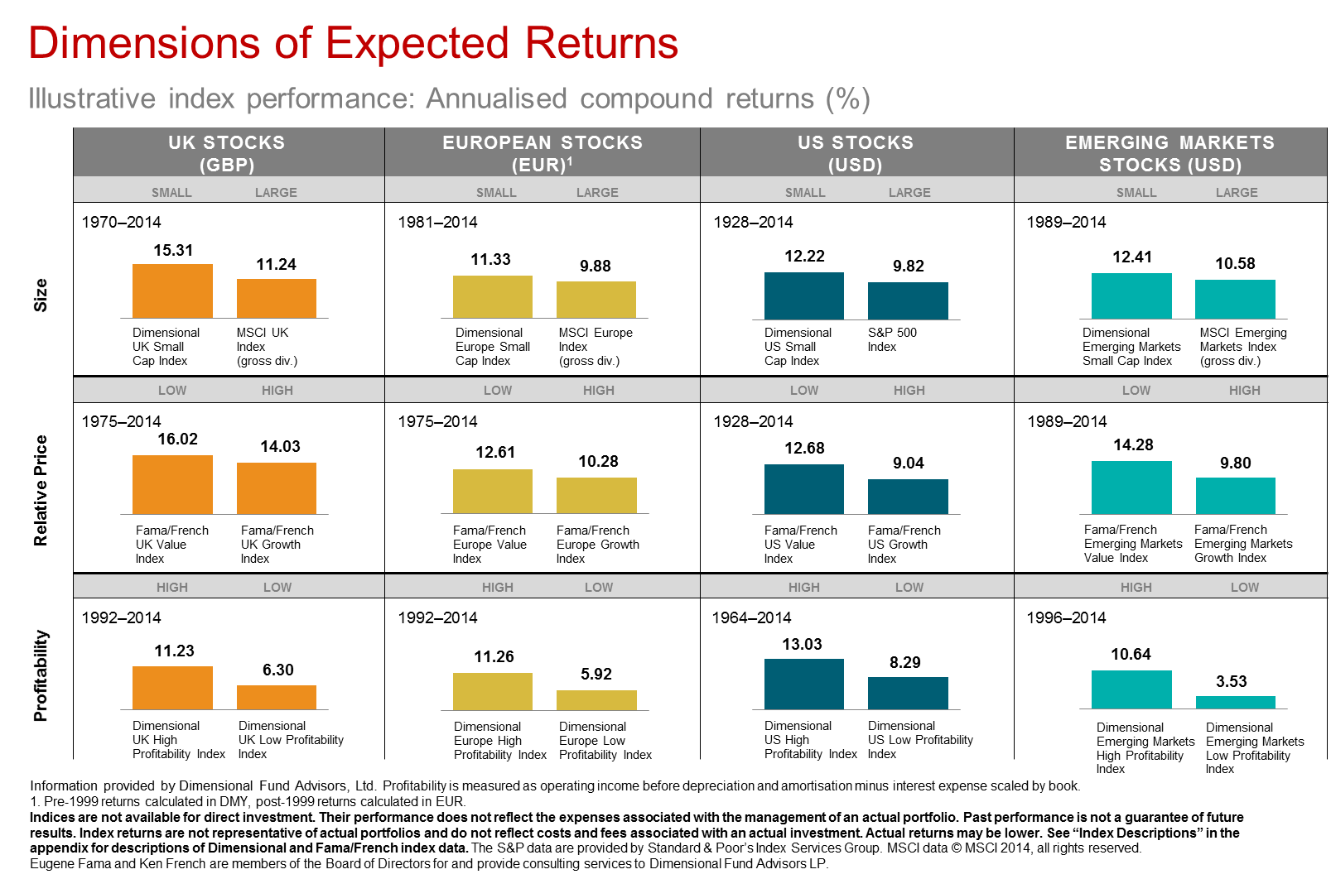
In order to get the best possible equity market return, we focus clients’ exposure on dimensions of higher expected return that various academics have identified, notably Professor Gene Fama, of the University of Chicago Booth School of Business, and Professor Ken French, of the Tuck School of Business, Dartmouth College.
Their research suggests that smaller companies and low-priced companies (that is companies whose book value of assets is high relative to their market price) perform better than the market average over time.
Because risk and return are related, the higher expected return comes at a price and, as a consequence, investing in these companies is riskier than investing in the whole market. There are periods when these groups of shares underperform the market, but over time, the academic research indicates that these risk premiums have been worth paying for.
The chart alongside shows how much these risk premiums have rewarded investors in comparison to an investment in the whole market in countries around the world. We therefore tilt our clients’ portfolios towards small and value companies, wherever possible, to the extent that is appropriate to the investor and their long-term goals.
This graph demonstrates the higher expected returns offered by small cap stocks and value stocks in the UK, Europe, US, and Emerging Markets.
The past is not necessarily a guide to future performance

Slide 5
Smart Strategies
Asset Allocation
Liquidity | 10%
Defensive Fixed Interest | 28%
Fixed Interest | 18%
Inflation Linked | 6%
Property | 8%
Equity | 15%
Global Small/Value Equity | 12%
Emerging Markets | 3%
Smart Cautious
Client’s opting for this portfolio would have low-medium risk tolerance, you would likely be concerned about the possibility of losing money and looking for more modest returns. You will likely have some experience of investment products and find that low risk investments such as bank deposits unattractive.
You are likely to accept some fluctuation in value for the potential for growth, you would be comfortable that the investment time horizon is greater than 7 years.
Examples of investments may include Fixed Interest Securities, Property, UK Equities, International Equities and Emerging Markets.
Some investments may be above or below your selected attitude to risk and in isolation may not be suitable and should only be considered as part of a blended portfolio.
You could get back less than you invested.
Asset Allocation Methodology | Strategic
Risk Mandate | Medium
Risk Groups | 1 | 2 | 3 | 4 | 5 | 6 | 7 | 8 | 9 | 10
Liquidity Management | Cash outside of the portfolio
Rebalancing Frequency | Annually
Investment Strategy | Global with Small/Value Tilts
Cost | 0.37%
Performance
Target Volatility | 6.79%
Lower Target | 5.45%
Upper Target | 8.14%
Simulated 15-year Volatility – 29/04/2004 – 28/02/2019 | 5.00%
Annualised Return since Inception 15/12/2015 – 28/03/2019 | 5.23%
Max Loss over the period 27/03/2004 – 22/03/2019 | 25.73%
Max Drawdown over the period 27/03/2004 – 22/03/2019 | -10.57%
Max Drawdown over the period 27/03/2004 – 22/03/2019
Max Loss is the largest fall without making a gain.
Max Drawdown is the fall from the highest point to the lowest point.
Max Gain is the largest gain without making a loss.
Both are calculated on a price bais.
The past is not necessarily a guide to future performance

Slide 6
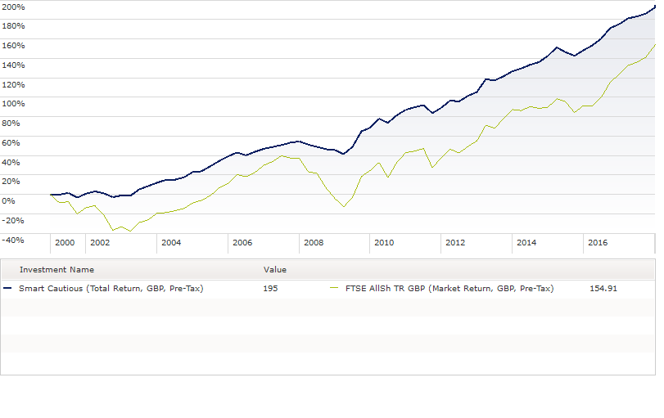
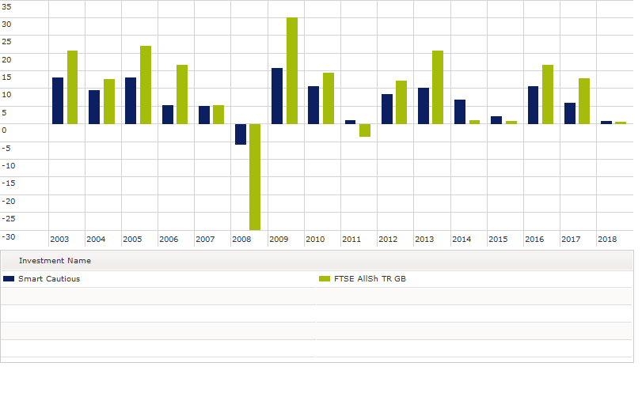
Performance
Performance vs the FTSE All Share December 2000-Jan Dec 2017
15 Year Returns by Calendar year versus the FTSE All Share
The past is not necessarily a guide to future performance

Slide 7
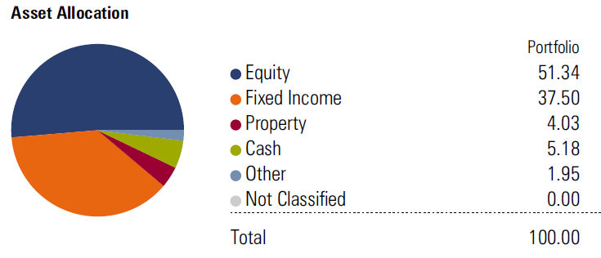
Smart Strategies
Asset Allocation
Liquidity | 5%
Defensive Fixed Interest | 20%
Fixed Interest | 14%
Inflation Linked | 5%
Property | 5%
Equity | 25%
Global Small/Value Equity | 20%
Emerging Markets | 6%
Smart Balanced
Client’s opting for this portfolio would have medium risk tolerance, and would probably prefer investments to fluctuate less and make more modest returns than risk losing money for higher returns.
It is likely that you are looking for a balance between risk and reward. You would be comfortable that the investment time horizon is greater than 7 years and you may have some experience of investment.
Examples of investments may include Fixed Interest Securities, Property, UK Equities, International Equities and Emerging Markets.
Some investments may be above or below your selected attitude to risk and in isolation may not be suitable and should only be considered as part of a blended portfolio.
You could get back less than you invested.
Asset Allocation Methodology | Strategic
Risk Mandate | Medium
Risk Groups | 1 | 2 | 3 | 4 | 5 | 6 | 7 | 8 | 9 | 10
Liquidity Management | Cash outside of the portfolio
Rebalancing Frequency | Annually
Investment Strategy | Global with Small/Value Tilts
Cost | 0.33%
Simulated Performance
Target Volatility | 9.14%
Lower Target | 8.14%
Upper Target | 10.15%
Simulated 15-year Volatility | 7.28%
Annualised Return since 29/12/2000 | 6.90%
Best 1 Year Return | 32.60%
Worst 1 Year Return | -15.21%
The past is not necessarily a guide to future performance

Slide 8
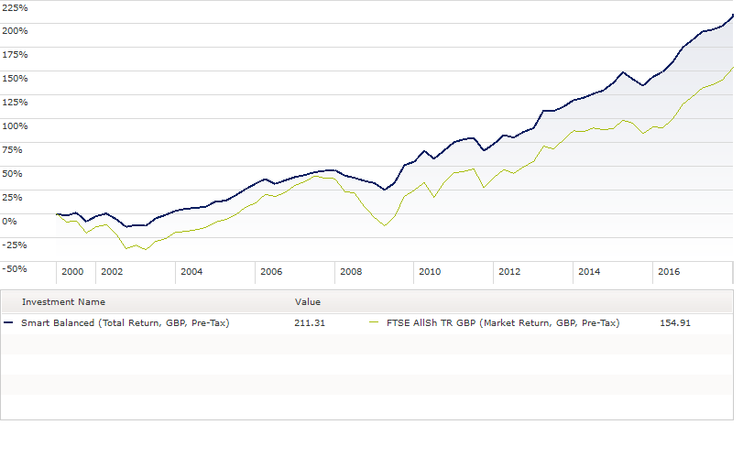
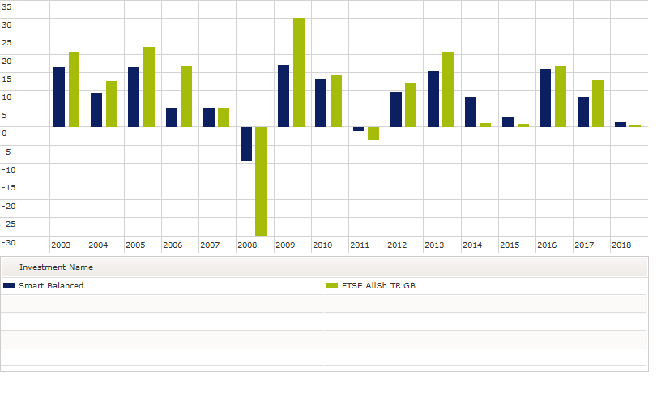
Performance
Performance vs the FTSE All Share December 2000-Jan Dec 2017
15 Year Returns by Calendar year versus the FTSE All Share
The past is not necessarily a guide to future performance

Slide 9
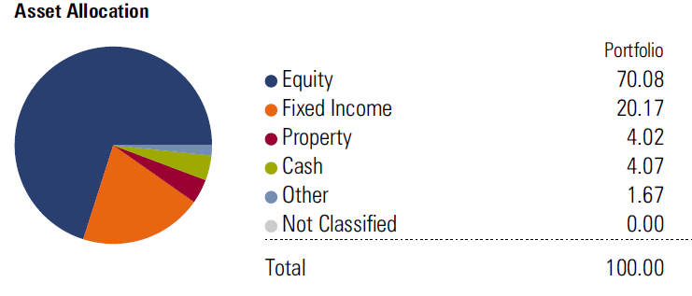
Smart Strategies
Asset Allocation
Liquidity | 3%
Defensive Fixed Interest | 5%
Fixed Interest | 12%
Inflation Linked | 5%
Property | 5%
Equity | 35%
Global Small/Value Equity | 25%
Emerging Markets | 10%
Smart Adventurous
Client’s opting for this portfolio would have medium high-risk tolerance, they would likely have experience in investing. Investors are probably more focused on returns and willing to put more of their capital at risk.
You are likely to accept a greater degree of fluctuation in value for the potential for higher return. You are likely to understand that greater fluctuations are crucial to generating returns. You would be comfortable that the investment time horizon is greater than 7 years.
Examples of investments may include Fixed Interest Securities, Property, UK Equities, International Equities and Emerging Markets.
Some investments may be above or below your selected attitude to risk and in isolation may not be suitable and should only be considered as part of a blended portfolio.
You could get back less than you invested.
Asset Allocation Methodology | Strategic
Risk Mandate | Medium
Risk Groups | 1 | 2 | 3 | 4 | 5 | 6 | 7 | 8 | 9 | 10
Liquidity Management | Cash outside of the portfolio
Rebalancing Frequency | Annually
Investment Strategy | Global with Small/Value Tilts
Cost | 0.30%
Simulated Performance
Target Volatility | 11.47%
Lower Target | 10.15%
Upper Target | 12.80%
Simulated 15-year Volatility | 9.69%
Annualised Return since 29/12/2000 | 7.35%
Best 1 Year Return | 41.01%
Worst 1 Year Return | -21.41%
The past is not necessarily a guide to future performance

Slide 10
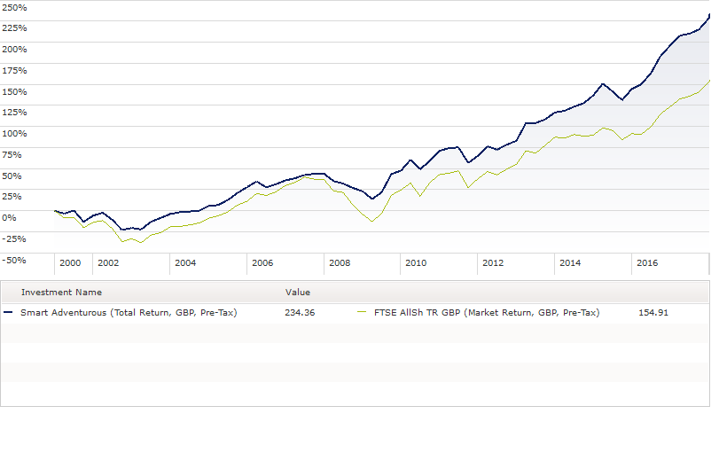
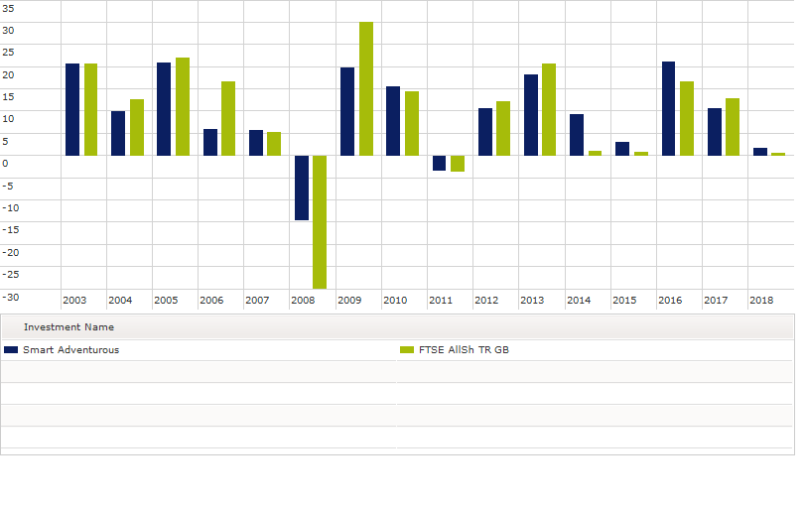
Performance
Performance vs the FTSE All Share December 2000-Jan Dec 2017
15 Year Returns by Calendar year versus the FTSE All Share
The past is not necessarily a guide to future performance

Slide 11
Using a Wrap Platform
At Zen Wealth our Model Portfolio Service is implemented via a Wrap Platform. We believe that Platforms will play a major role in the delivery of our portfolio based solution. We utilise Wrap Platforms to implement the strategy.
Advantages of investing via a platform
The ability to hold one or a number of different investment vehicles “under one roof”.
It provides access to a significant number of investment funds from different fund managers to allow the creation of a diversified portfolio with the ability to switch funds at any time.
It also provides the facility to obtain up-to-date valuations on all your investments whenever required.
Disadvantages of investing via a platform
The platform provider imposes charges on funds held on the platform. Some of the charges may be significantly higher than are incurred by purchasing more traditional products, however, the ability to purchase funds at a significant discount and the ability to switch funds throughout the platform at no additional cost, reduces the overall cost and allows us to deliver a higher quality service than would be available through individual product purchases.
Our selection process identified a range of funds which are not available via more traditional products. We believe that by utilising Wrap Platforms we can offer the highest level of service. We are not tied to one provider. We individually match the Wrap Platform to your specific needs and requirement from the portfolio service we can provide.
Due to the complexities of managing such a range of portfolios, we currently utilise two Platforms, Transact and Aegon Retirement Choices. This said, it is possible to build and construct the portfolios on other platforms and we will only recommend a solution once we have considered your wider circumstances.
When you meet with us, we will get to understand your individual circumstances and ask you to complete a risk profile questionnaire. This will enable us to have an informed discussion about whether a Model Portfolio is suitable and if so which model would best suit your needs.
We will never make changes to your investment portfolio without your authority. We will send you a review report which will outline our recommendation and give you the information you need to make a decision.
While we are keen to promote the service it will not suit everyone. If our discussions lead us to believe something else would be more suitable whether it is a more traditional single product, a single managed fund or a bespoke portfolio.
Glossary
OCF (Ongoing Charge Figure) – The OCF is a measure of the total cost of an investment to the investor. It may include various fees (purchase, redemption, management) and other expenses. Typically it consists of an annual management charge (the fee that the fund company charges annually to manage the fund) plus other charges incurred in running the fund such as legal fees, share registration and custodian costs.
Volatility – Measures the variation in price of a financial instrument over time. Historically volatility is derived from looking at past prices and tracking the frequency and degree of changes.
Standard Deviation – is a statistical measurement which looks at historical volatility. It looks at how likely an investment is to deviate from its average return.
Wrap Platform - A Wrap Platform provides a means of holding all your investments in one place. It normally comprises of three services. Firstly it provides administrative systems and process which allow your investments to be managed in one place. Secondly, it provides an arrangement for buying and selling investments efficiently and thirdly the ability to access various tax efficient investment and savings vehicles.
Active/Passive and Blended— Investment styles are often categorised as active or passive. An active investor is one who makes decisions about holding one investment over another. Passive investors are willing to accept the market rate of return and usually enjoy paying smaller fees than active investors.
Our investment philosophy is passive (where we believe markets are efficient) to the extent that we are not making judgements on the relative merits of one investment over another, but we are not willing to accept the market rate (less fees) for our clients. Our investment process targets market-beating performance through structured exposure to dimensions of higher expected return, and uses methods of portfolio construction and implementation that we hope enhance performance relative to the average investor.
The past is not necessarily a guide to future performance

Slide 12
Level 30
The Leadenhall Building
122 Leadenhall Street
London
EC3V 4AB
Tel: 020 3753 4638
Zen Wealth LLP is an appointed representative of Best Practice IFA Group Limited which is authorised and regulated by the Financial Conduct Authority.

